Slide 1
Time Division Multiplexing (TDM)
Time Division Multiplex:A single carrier frequency
channel is shared by a number of users, one after
another. Transmission is organized in repetitive
“time-frames”. Each frame consists of groups of
pulses - time slots.
Each user is assigned a separate time-slot.
All senders use same frequency in at different time
Precise clock synchronisation required

Slide 2
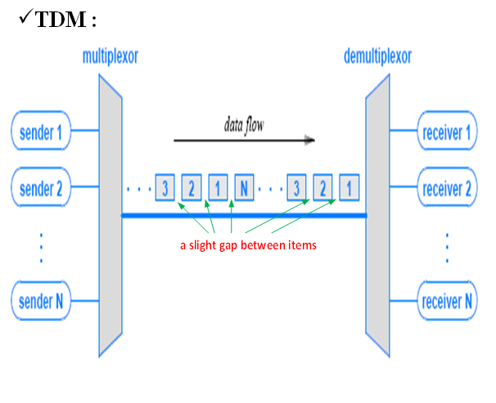

Slide 3
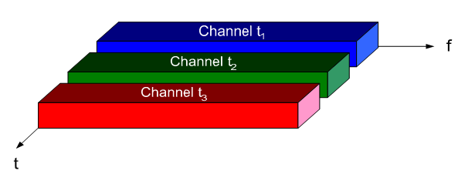
TDM :

Slide 4
TDM
TDM
Power density
Time-frame
Frequency
Time
Frequency
Time
Time slot
Example: DECT (Digital enhanced cordless phone) Frame lasts 10 ms, consists of 24 time slots (each 417μs)

Slide 5
Combining FDM/TDM
By allowing a channel to use a certain frequency
for a certain period of time more efficient use of
resource is achieved.
More robust against interference and tapping.
This is the scheme used by GSM between the
handset and base station.
Requires coordination between the different
senders.
Two senders will interfere if they select the same
frequency.

Slide 6
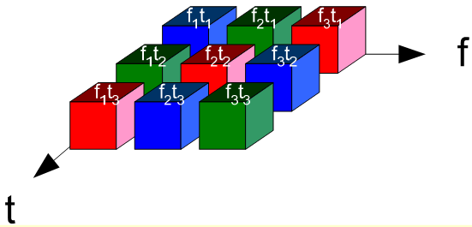
Combining FDM/TDM
To avoid this the senders hop between frequencies:
if the hop is fast enough the period of interference may be so
small that if the coding of the data signal is sufficient to allow
the receiver to recover the data the interference is deemed
acceptable.

Slide 7
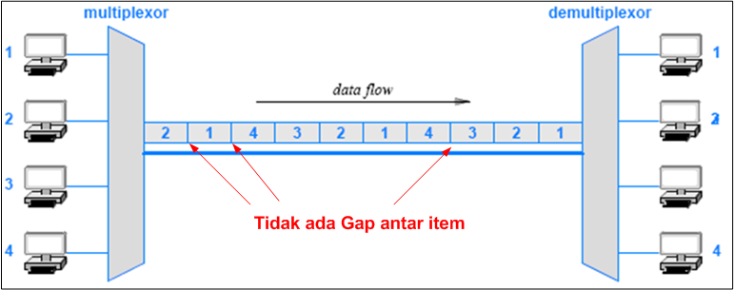
Synchronous TDM
  When TDM is applied to synchronous networks,
  no gap occurs between items; the result is known
  as Synchronous TDM.

Slide 8
Framing Used in the Telephone SystemVersion of TDM
Telephone systems use synchronous TDM to multiplex
digital streams from multiple phone calls
  they use the acronym TDM to refer to the specific
  form of TDM used to multiplex digital telephone calls.
The phone system TDM includes an interesting technique
  to insure that a demultiplexer stays synchronized with the
  multiplexer.
Why is synchronization needed?
  observe that a synchronous TDM sends one slot after
  another without any indication of the output to which
  a given slot occurs.
  A demultiplexer cannot tell where a slot begins– a
  slight difference in the clocks used to time bits can
  cause a demultiplexer to misinterpret the bit stream

Slide 9
Framing Used in the Telephone SystemVersion of TDM
To prevent misinterpretation, the version of TDM
used in the phone system includes an extra framing
channel as input.
Instead of taking a complete slot, framing inserts a
single bit in the stream on each round.
A demultiplexor extracts data from the framing
channel and checks for alternating 0 and 1 bits.
If an error causes a demultiplexor to lose a bit
  it is highly likely that the framing check will
  detect the error and allow the transmission to
  be restarted.

Slide 10
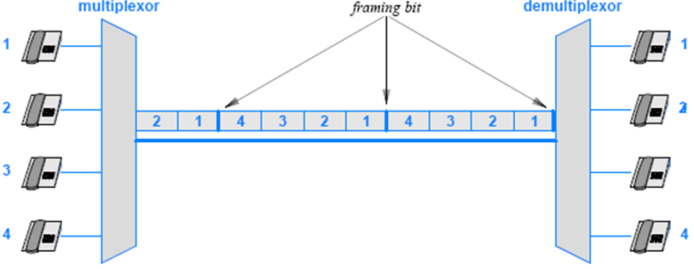
Framing Used in the Telephone SystemVersion of TDM

Slide 11
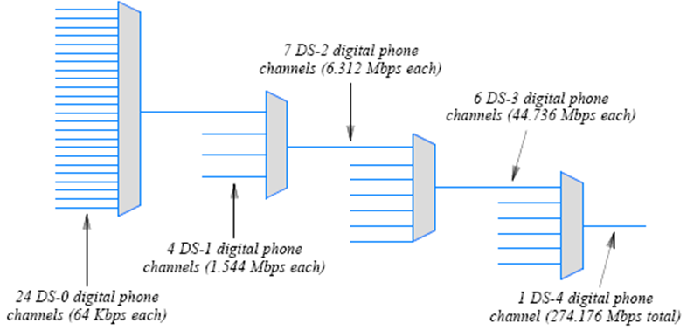
Hierarchical TDM

Slide 12
The Problem with Synchronous TDM: Unfilled Slots
Synchronous TDM works well if each source produces data
at a uniform, fixed rate equal to 1/N of the capacity of the
shared medium.
Many sources generate data in bursts, with idle time between
bursts.
To understand why, consider the example in Figure 11.12
  sources on the left produce data items at random.
  the synchronous multiplexor leaves a slot unfilled
    if the corresponding source has not produced an item
    by the time the slot must be sent.
In practice, a slot cannot be empty because the underlying
system must continue to transmit data.
  the slot is assigned a value (such as zero).
  and an extra bit is set to indicate that the value is invalid.

Slide 13
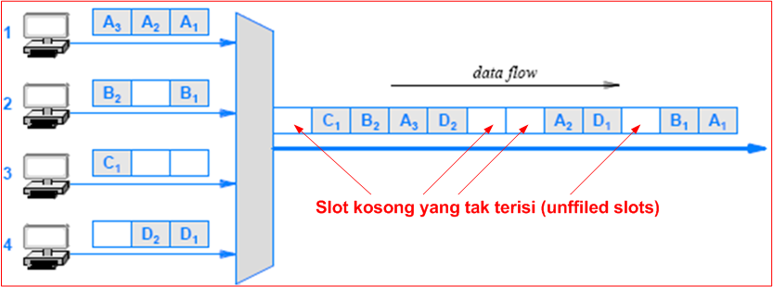
The Problem with Synchronous TDM: Unfilled Slots

Slide 14
Statistical TDM
How can a multiplexing system make better use of a shared
medium?
One technique to increase the overall data rate is known as
statistical TDM or statistical multiplexing
  some literature uses the term asynchronous TDM
The technique is straightforward:
  select items for transmission in a round-robin fashion
  but instead of leaving a slot unfilled, skip any source
  that does not have data ready
By eliminating unused slots
  statistical TDM takes less time to send the same amount
  of data

Slide 15
Statistical TDM
Statistical multiplexing incurs extra overhead shown below:
  Consider demultiplexing:
    In a synchronous TDM system a demultiplexor knows
    that every N slot corresponds to a given receiver
    In a statistical multiplexing system, the data in a given
    slot can correspond to any receiver
  Each slot must contain the identification of the receiver
  to which the data is being sent
Later chapters discuss identification mechanisms
  that are used with statistical multiplexing in packet
  switching networks and the Internet

Slide 16
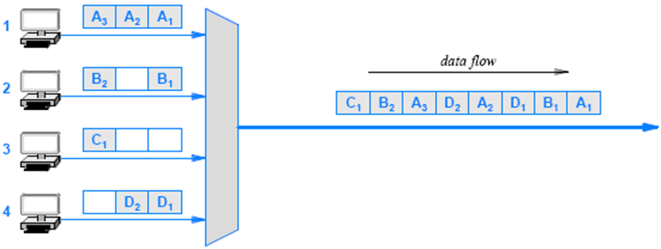
Statistical TDM

Slide 17
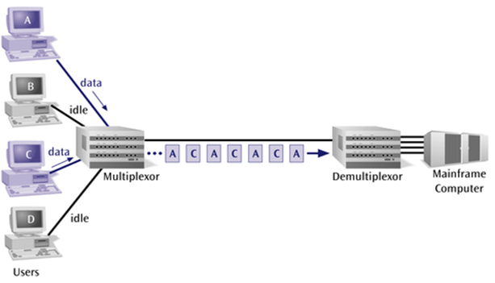
Statistical TDM

Slide 18
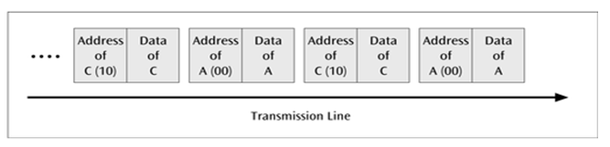
Statistical TDM
To identify each piece of data, an address is included.

Slide 19
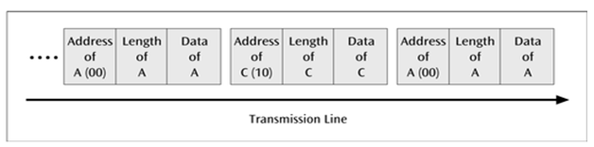
Statistical TDM
If the data is of variable size, a length is also included.

Slide 20
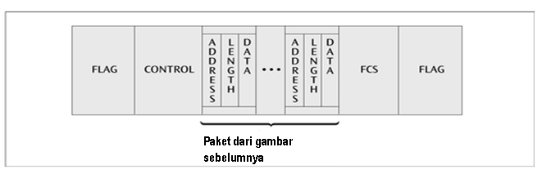
Statistical TDM
More precisely, the transmitted frame contains a collection
of data groups

Slide 21
Code Division Multiplexing (CDM)
All channels use the same frequency, however, each
channel is given its own unique code
Each code must be sufficiently orthogonal to allow
appropriate guard spaces
Large range of codes provides significant expansion,
security, etc
Highly complex scheme
Receiver has to know the code & be able to separate
out other traffic on different codes which appear as
background noise

Slide 22
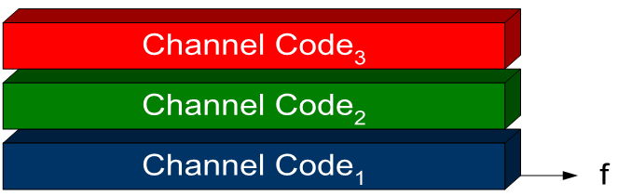
Code Division Multiplexing (CDM)
Receiver & transmitter must be synchronised to
provide correct decoding
All signals must reach the receiver with relatively
equal strength or the receiver will not be able to
distinguish between them

Slide 23
CDMA or SS
Code Division Multiple Access or Spread Spectrum
communication techniques
  FH: frequency hoping (frequency synthesizer controlled by pseudo-random sequence of numbers)
  DS: direct sequence (pseudo-random sequence of pulses used for spreading)
  TH: time hoping (spreading achieved by randomly spacing transmitted pulses)
  Other techniques
    Hybrid combination of the above techniques
    (radar and other applications)
    Random noise as carrier

Slide 24
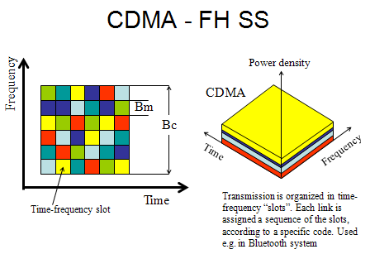

Slide 25
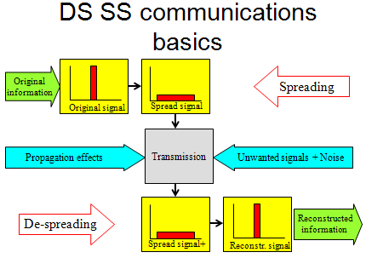

Slide 26
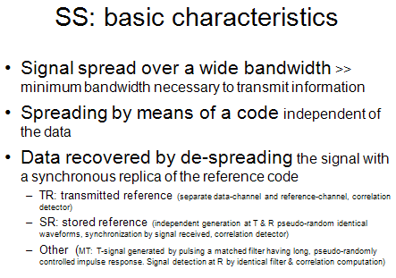

Slide 27
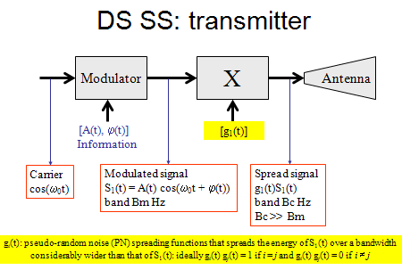

Slide 28
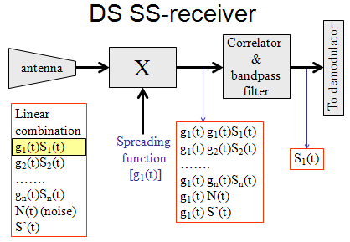

Slide 29
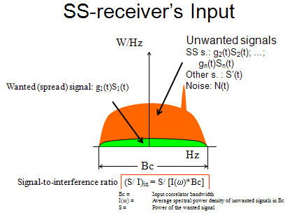

Slide 30
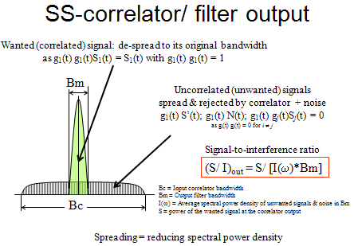

Slide 31
Code Division Multiplexing (CDM)
CDM used in parts of the cellular telephone system and for some satellite communication
  The specific version of CDM used in cell phones is known as Code Division Multi-Access (CDMA)
CDM does not rely on physical properties
  such as frequency or time
CDM relies on an interesting mathematical idea
  values from orthogonal vector spaces can be combined and separated without interference
Each sender is assigned a unique binary code C_{i}
  that is known as a chip sequence
  chip sequences are selected to be orthogonal vectors
  (i.e., the dot product of any two chip sequences is zero)

Slide 32
Code Division Multiplexing
At any point in time, each sender has a value to transmit, V_{i}
  The senders each multiply C_{i} x V_{i} and transmit the results
The senders transmit at the same time
  and the values are added together
To extract value V_{i}, a receiver multiplies the sum by C_{i}
Consider an example
  to keep the example easy to understand, use a chip sequence that is only two bits long and data values that are four bits long
  think of the chip sequence as a vector

Slide 33
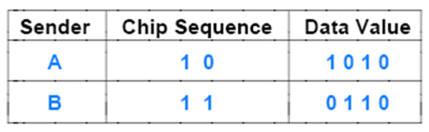
Code Division Multiplexing

Slide 34
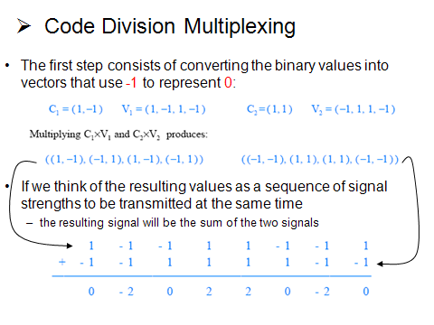

Slide 35
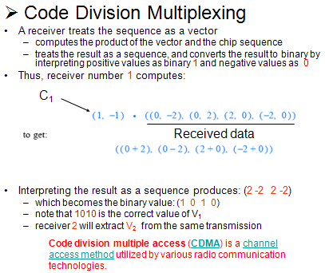

Slide 36
Wavelength Division Multiplexing (WDM)
Prisms form the basis of optical multiplexing and demultiplexing
  a multiplexor accepts beams of light of various wavelengths and uses a prism to combine them into a single beam
  a demultiplexor uses a prism to separate the wavelengths.

Slide 37
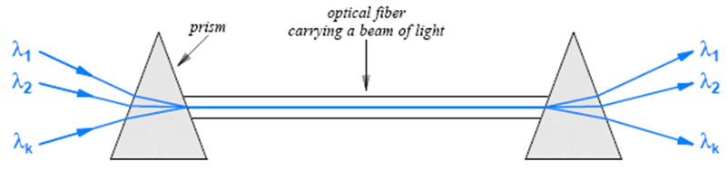
Give each message a different wavelength (frequency)
Easy to do with fiber optics and optical sour

Slide 38
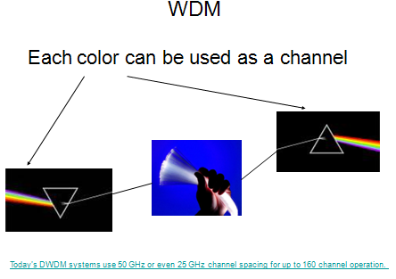

Slide 39
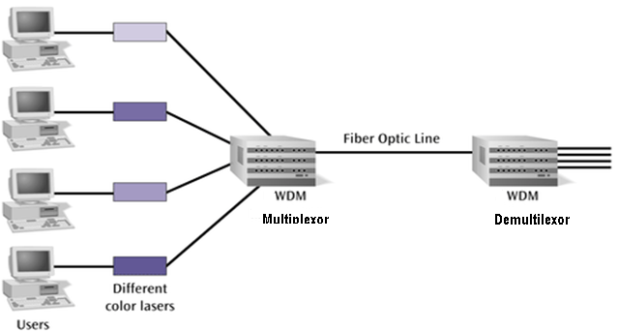

Slide 40
